Slide 1

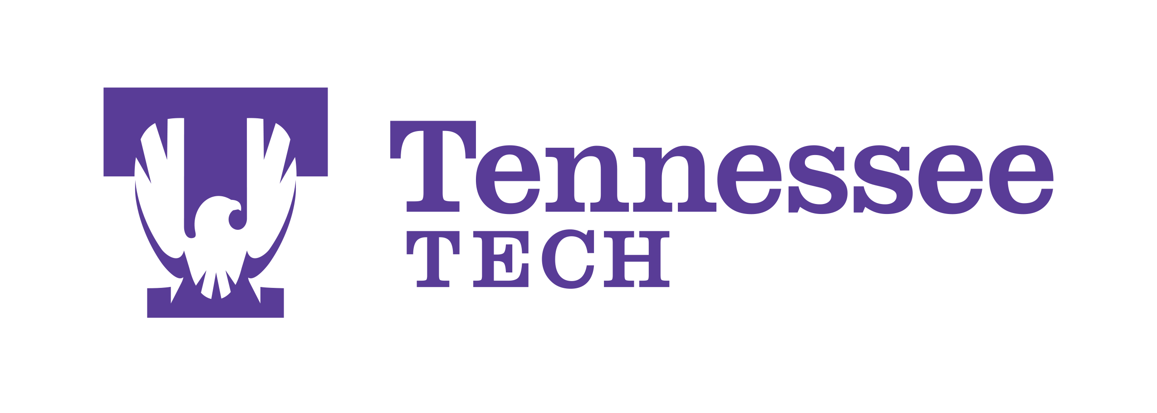
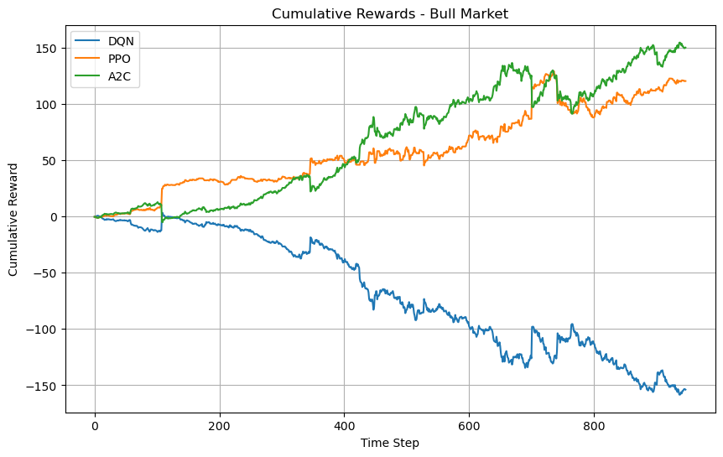
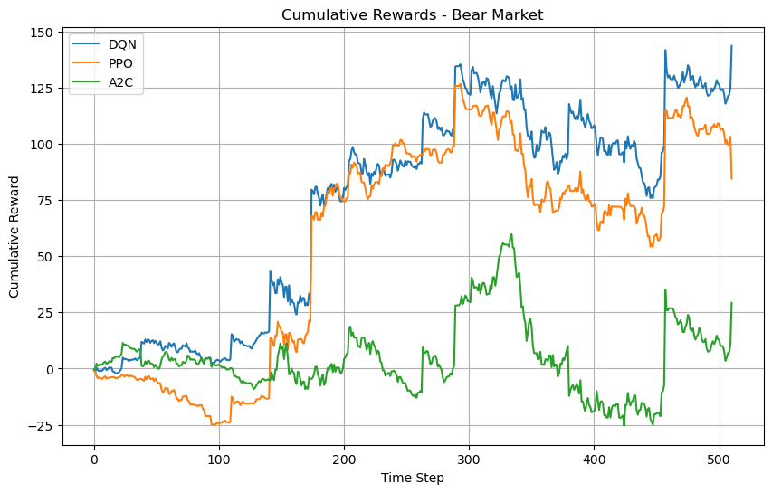
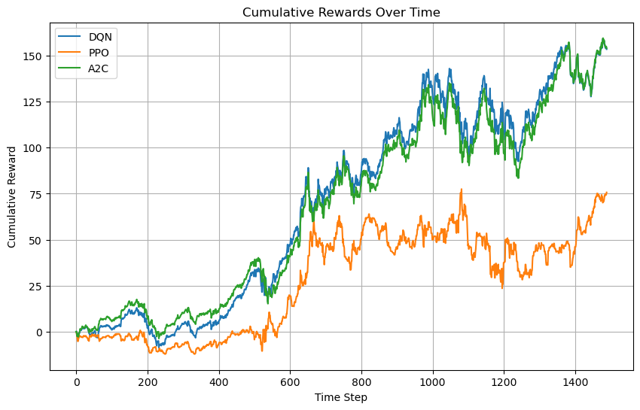
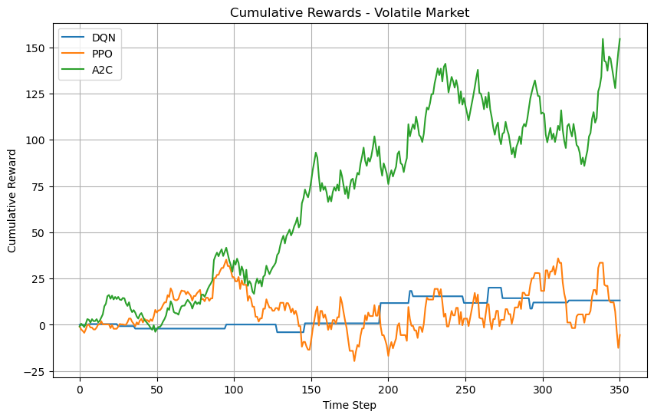
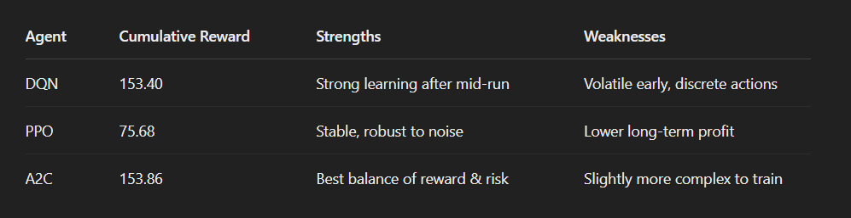
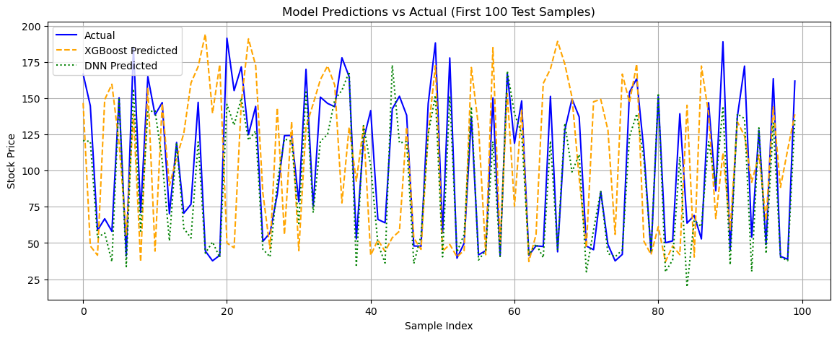
Comparing Deep Reinforcement Learning and Traditional Machine Learning Methods for Adaptive Portfolio Management
Blaine Swieder, Department of Computer Science, Tennessee Technological University
Abstract
This project investigates the effectiveness of Deep Reinforcement Learning (DRL) versus traditional Machine Learning (ML) methods in stock market prediction and adaptive trading strategy development. We compare traditional models, such as Gradient Boosting Machines (GBM) and Deep Neural Networks (DNN), with DRL agents including Deep Q-Networks (DQN), Proximal Policy Optimization (PPO), and Advantage Actor-Critic (A2C).Our analysis leverages historical stock data from 2018 to 2023, evaluates models under dynamic market regimes—bullish, bearish, and sideways—and uses a custom trading environment to simulate real-world trading decisions. Key evaluation metrics include Mean Squared Error (MSE), R², Sharpe Ratio, Sortino Ratio, and Maximum Drawdown. Results indicate that while GBM leads in raw predictive accuracy, A2C and PPO demonstrate stronger adaptability and risk-adjusted returns. These findings highlight the promise of DRL approaches in dynamic portfolio management and open the door for future research in real-time algorithmic trading.
Deep Reinforcement Learning Models
We implemented and compared three DRL algorithms using stable-baselines3 in a custom OpenAI Gym-compatible trading environment:
Deep Q-Network (DQN):A value-based method that learns the expected return (Q-value) for each action. It uses an epsilon-greedy policy for exploration but struggled with the complexity and volatility of the stock environment.
Proximal Policy Optimization (PPO): A policy-gradient method that optimizes a clipped objective function to ensure stable updates. PPO performed consistently well across market conditions and was robust to noisy data.
Advantage Actor-Critic (A2C):Combines policy and value-based approaches. A2C uses an actor to propose actions and a critic to evaluate them. It achieved the best performance in cumulative reward and risk-adjusted returns.
Figure: Cumulative Rewards – Bull Market A2C delivered the strongest gains, closely followed by PPO. DQN underperformed significantly, accumulating losses in a trending market.
Dataset & Preprocessing
We used daily stock data from 2018 to 2023, which includes standard market features: Open, High, Low, Close, and Volume (OHLCV). For ML models, the target variable was the next day’s closing price. Features were scaled using MinMaxScaler, and rows with missing data were removed.
To evaluate adaptability, we segmented the dataset into three market regimes:
Bullish: Price consistently above 30-day rolling average
Bearish: Price consistently below 30-day rolling average
Sideways: Daily changes within ±2%
These subsets allowed us to simulate realistic financial environments.
Figure: Cumulative Rewards – Bear Market
PPO and DQN were surprisingly effective, preserving capital during drawdowns. A2C was more volatile and less consistent here.
Traditional Models
Gradient Boosting Machine (GBM): Used an ensemble of decision trees to minimize error. GBM provided the highest R² score and lowest mean squared error, making it the strongest traditional model for prediction.
Deep Neural Network (DNN): Implemented using Keras with multiple dense layers and dropout regularization. It showed solid performance but struggled with volatility in real-world data.
Evaluation Metrics:
MSE (Mean Squared Error): This measures average error magnitude.
R² (R-squared): Reflects how well the model explains variance in the data.
Figure: DRL Cumulative Rewards Over Time A2C and DQN achieved comparable total rewards (~153), outperforming PPO (~75). Despite PPO's stability, it lagged in maximizing long-term gains.
Figure: Cumulative Rewards – Volatile Market
A2C showed superior handling of fluctuations, steadily accumulating reward. DQN and PPO failed to exploit minor movements effectively.
Conclusions
A2C was the best-performing DRL agent, particularly in bull and volatile markets.
PPO offered strong stability across regimes.
Traditional ML models, especially GBM, provide solid benchmarks but lack regime-specific adaptability.
DRL provides a dynamic edge, adapting strategies to shifting market environments.
Future improvements include incorporating transaction costs, multi-agent competition, and high-frequency trading strategies.
Training Details & Environment Design
Each DRL agent was trained utilizing the following:
Each agent was trained for 10,000 timesteps using stable-baselines3.
The custom OpenAI Gym environment simulated trading with discrete (DQN) and continuous (PPO, A2C) action spaces.
Reward Function: Based on changes in portfolio value after each action.
The environment tracked cash balance, shares held, and total net worth, returning a numeric observation vector at each time step.
Figure: Model Predictions vs. Actual Prices (First 150 Samples). GBM achieved lowest MSE and highest R².
Data Sources:
Historical stock prices from Yahoo Finance
Macroeconomic indicators from the Federal Reserve Economic Data (FRED): https://fred.stlouisfed.org

